Slide 1
Media queries, Flexbox, Grid system
By Julia Chayka

Slide 2
AGENDA
Media queries
Flexbox
Grid system

Slide 3
WHAT IS MEDIA QUERIES?
Along with media types, CSS3 includes support for various technical device parameters, based on which you need to load certain styles. For example, you can define a smartphone with a maximum resolution of 640 pixels and set some style properties for it, and others for other devices. You can also identify various characteristics such as the presence of a monochrome screen, orientation (portrait or landscape), etc. All characteristics can be easily combined, so it is permissible to set the style only for devices in landscape orientation with a given screen resolution.
The capabilities of media queries are not limited to identifying mobile devices, they can be used to create a responsive layout. This layout adjusts to the resolution of the monitor and browser window, changing the width of the layout, the number of columns, the size of images and text, if necessary. Media queries limit the width of the layout and when this value is reached (for example, by reducing the window or when viewed on a device with a specified size), a different style is already applied.

Slide 4
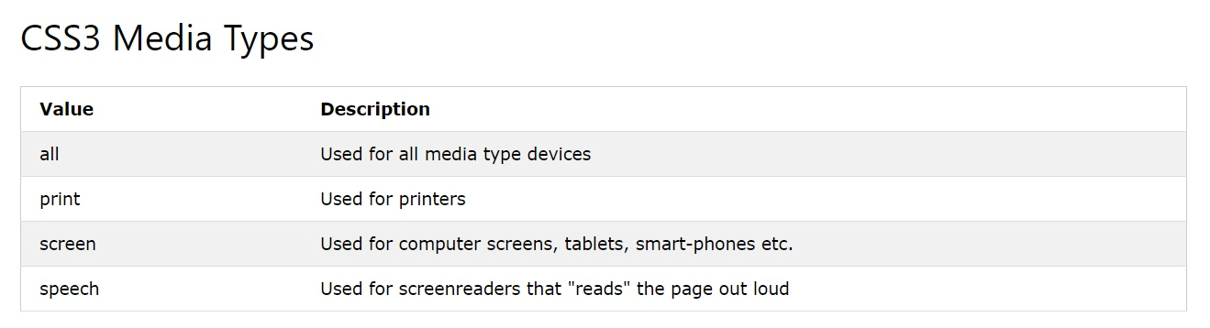
MEDIA QUERIES TYPES

Slide 5
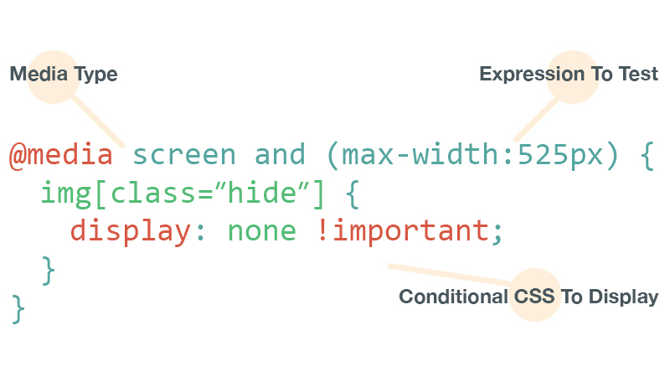
MEDIA QUERIES SYNTAXIS

Slide 6
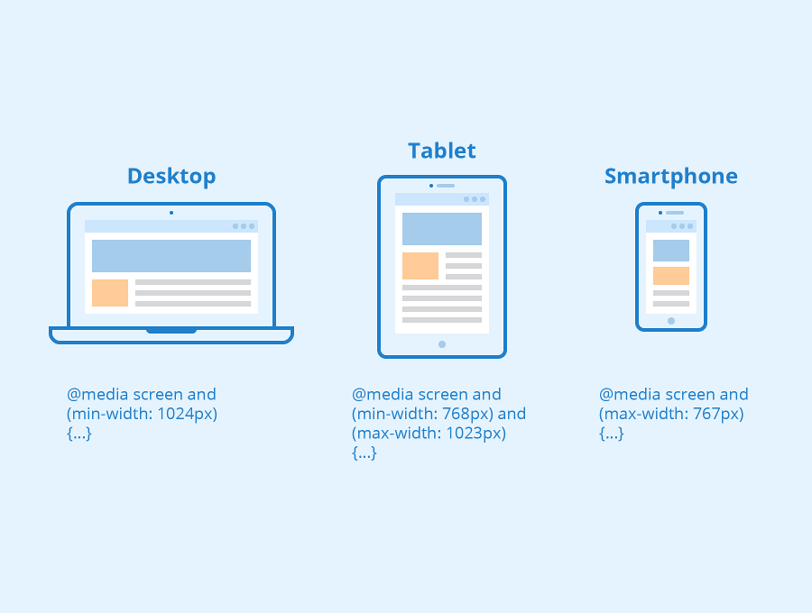
MEDIA QUERIES FOR ALL DEVICES

Slide 7
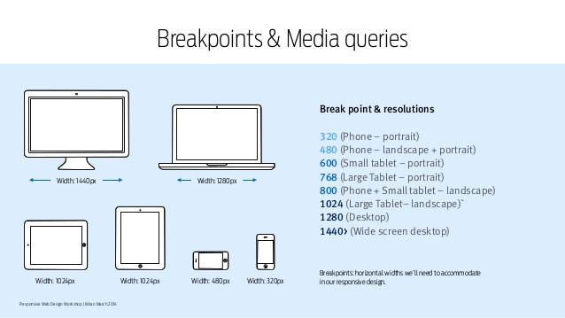
BREAKPOINTS

Slide 8
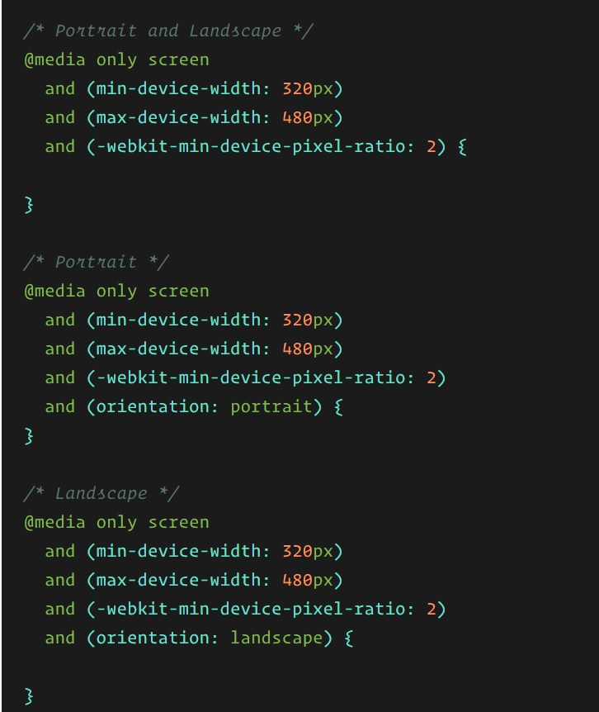
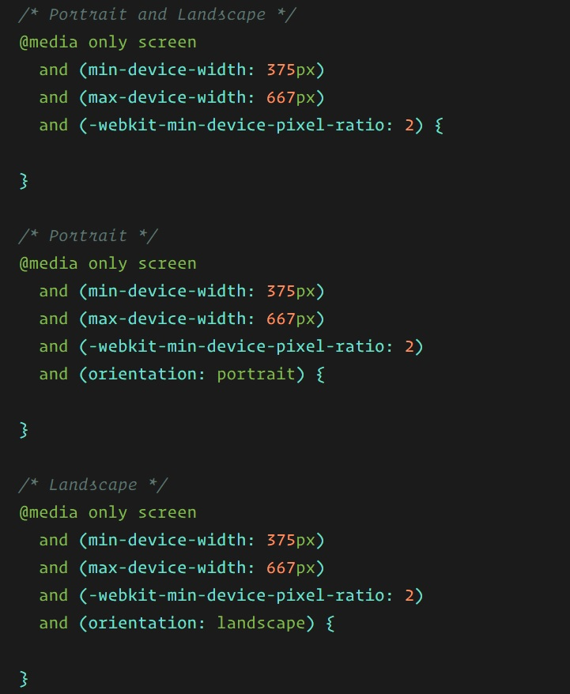
MEDIA QUERIES FOR STANDARD DEVICES
iPhone 5, 5S, 5C and 5SE
iPhone 6, 6S, 7 and 8

Slide 9
FLEXBOX
Since flexbox is a whole module and not a single property, it involves a lot of things including its whole set of properties. Some of them are meant to be set on the container (parent element, known as “flex container”) whereas the others are meant to be set on the children (said “flex items”).
If “regular” layout is based on both block and inline flow directions, the flex layout is based on “flex-flow directions”. Please have a look at this figure from the specification, explaining the main idea behind the flex layout.

Slide 10
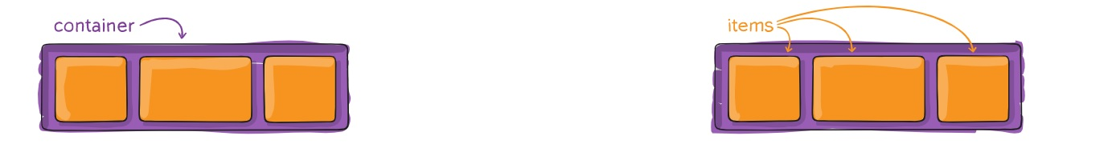
FLEX CONTEINER AND ITEMS
Parent
Children

Slide 11
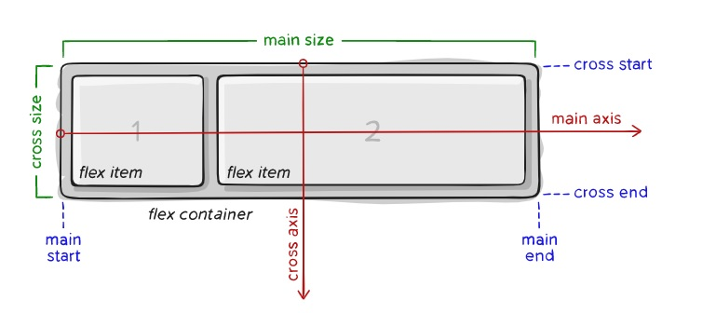
main size – A flex item’s width or height, whichever is in the main dimension, is the item’s main size. The flex item’s main size property is either the ‘width’ or ‘height’ property, whichever is in the main dimension.
cross axis – The axis perpendicular to the main axis is called the cross axis. Its direction depends on the main axis direction.
cross-start | cross-end – Flex lines are filled with items and placed into the container starting on the cross-start side of the flex container and going toward the cross-end side.
cross size – The width or height of a flex item, whichever is in the cross dimension, is the item’s cross size. The cross size property is whichever of ‘width’ or ‘height’ that is in the cross dimension.
Items will be laid out following either the main axis (from main-start to main-end) or the cross axis (from cross-start to cross-end).
main axis – The main axis of a flex container is the primary axis along which flex items are laid out. Beware, it is not necessarily horizontal; it depends on the flex-direction property (see below).
main-start | main-end – The flex items are placed within the container starting from main-start and going to main-end.

Slide 12
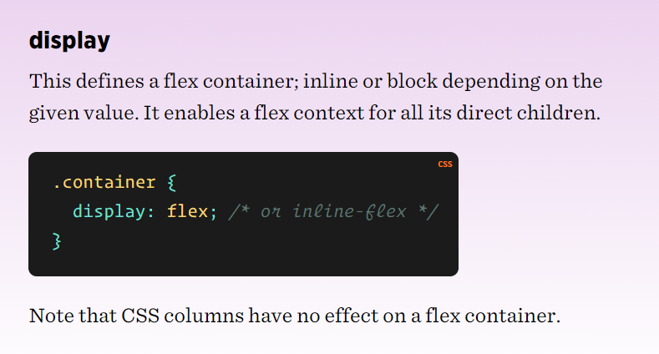
PROPERTIES FOR THE PARENT (FLEX CONTAINER)

Slide 13
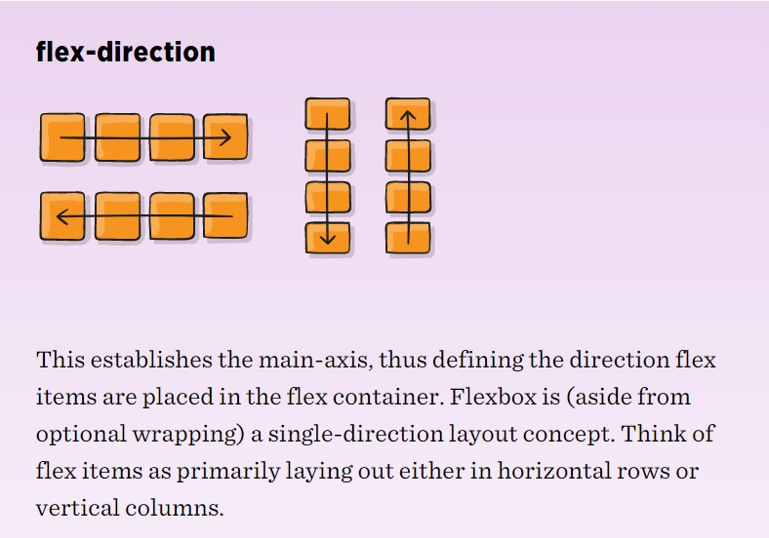
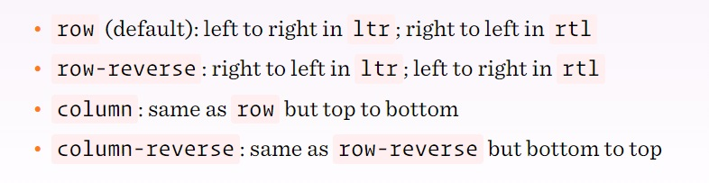
PROPERTIES FOR THE PARENT (FLEX CONTAINER)

Slide 14
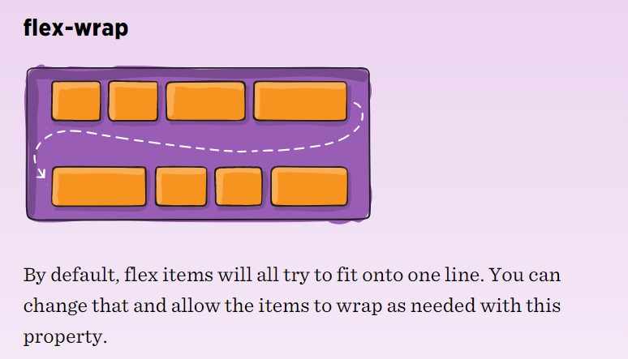
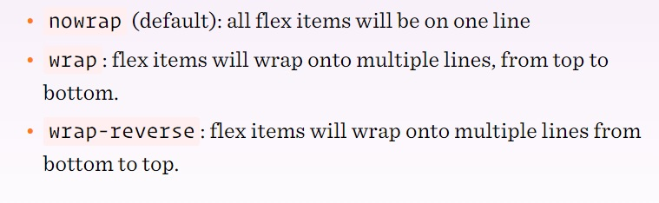
PROPERTIES FOR THE PARENT (FLEX CONTAINER)

Slide 15
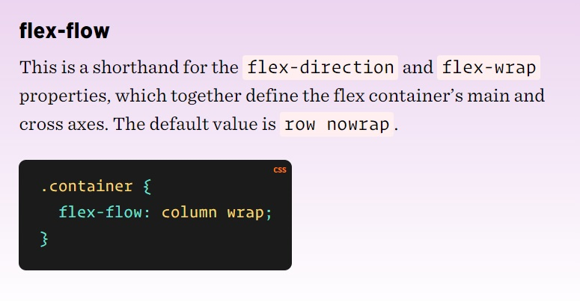
PROPERTIES FOR THE PARENT (FLEX CONTAINER)

Slide 16
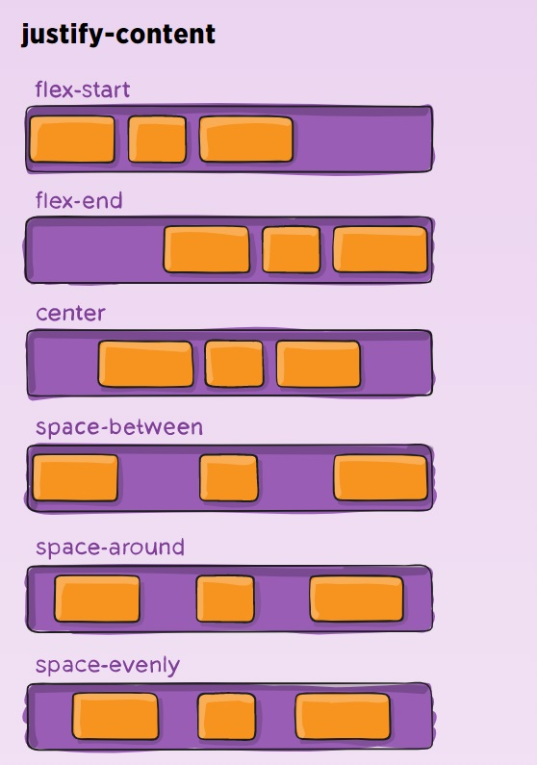
PROPERTIES FOR THE PARENT (FLEX CONTAINER)
flex-start (default): items are packed toward the start of the flex-direction.
flex-end: items are packed toward the end of the flex-direction.
start: items are packed toward the start of the writing-mode direction.
end: items are packed toward the end of the writing-mode direction.
left: items are packed toward left edge of the container, unless that doesn’t make sense with the flex-direction, then it behaves like start.
right: items are packed toward right edge of the container, unless that doesn’t make sense with the flex-direction, then it behaves like end.
center: items are centered along the line
space-between: items are evenly distributed in the line; first item is on the start line, last item on the end line
space-around: items are evenly distributed in the line with equal space around them. Note that visually the spaces aren’t equal, since all the items have equal space on both sides. The first item will have one unit of space against the container edge, but two units of space between the next item because that next item has its own spacing that applies.
space-evenly: items are distributed so that the spacing between any two items (and the space to the edges) is equal.

Slide 17
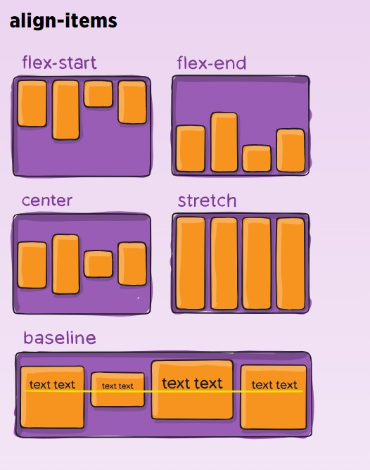
PROPERTIES FOR THE PARENT (FLEX CONTAINER)
stretch (default): stretch to fill the container (still respect min-width/max-width)
flex-start / start / self-start: items are placed at the start of the cross axis. The difference between these is subtle, and is about respecting the flex-direction rules or the writing-mode rules.
flex-end / end / self-end: items are placed at the end of the cross axis. The difference again is subtle and is about respecting flex-direction rules vs. writing-mode rules.
center: items are centered in the cross-axis
baseline: items are aligned such as their baselines align

Slide 18
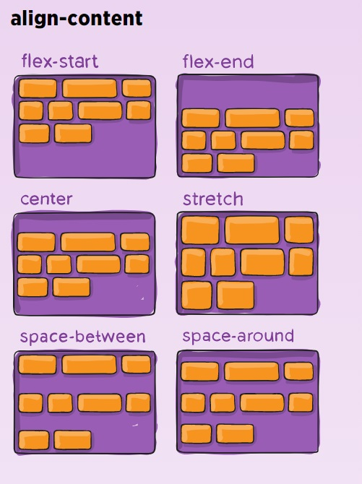
PROPERTIES FOR THE PARENT (FLEX CONTAINER)
normal (default): items are packed in their default position as if no value was set.
flex-start / start: items packed to the start of the container. The (more supported) flex-start honors the flex-direction while start honors the writing-mode direction.
flex-end / end: items packed to the end of the container. The (more support) flex-end honors the flex-direction while end honors the writing-mode direction.
center: items centered in the container
space-between: items evenly distributed; the first line is at the start of the container while the last one is at the end
space-around: items evenly distributed with equal space around each line
space-evenly: items are evenly distributed with equal space around them
stretch: lines stretch to take up the remaining space

Slide 19
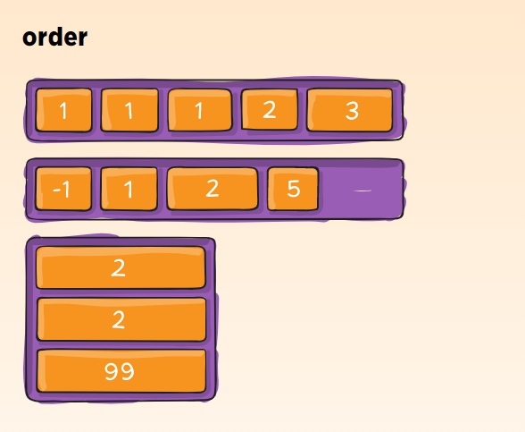
PROPERTIES FOR THE PARENT (FLEX CONTAINER)
By default, flex items are laid out in the source order. However, the order property controls the order in which they appear in the flex container.

Slide 20
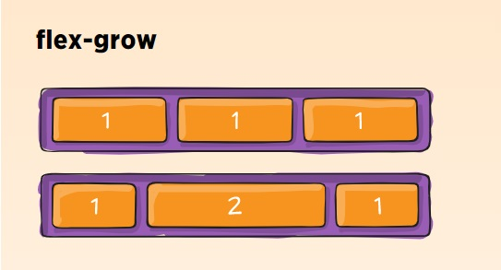
PROPERTIES FOR THE PARENT (FLEX CONTAINER)
This defines the ability for a flex item to grow if necessary. It accepts a unitless value that serves as a proportion. It dictates what amount of the available space inside the flex container the item should take up.
If all items have flex-grow set to 1, the remaining space in the container will be distributed equally to all children. If one of the children has a value of 2, the remaining space would take up twice as much space as the others (or it will try to, at least).

Slide 21
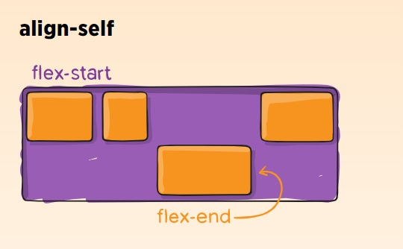
PROPERTIES FOR THE PARENT (FLEX CONTAINER)
.item {
align-self: auto | flex-start | flex-end | center | baseline | stretch;
}
Note that float, clear and vertical-align have no effect on a flex item.

Slide 22
GRID SYSTEM
CSS Grid Layout is the most powerful layout system available in CSS. It is a 2-dimensional system, meaning it can handle both columns and rows, unlike flexbox which is largely a 1-dimensional system. You work with Grid Layout by applying CSS rules both to a parent element (which becomes the Grid Container) and to that element’s children (which become Grid Items).

Slide 23
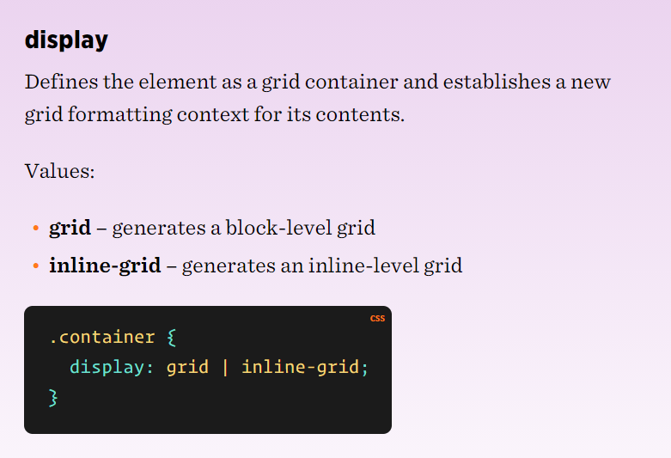
Properties for the Parent (Grid Container)

Slide 24
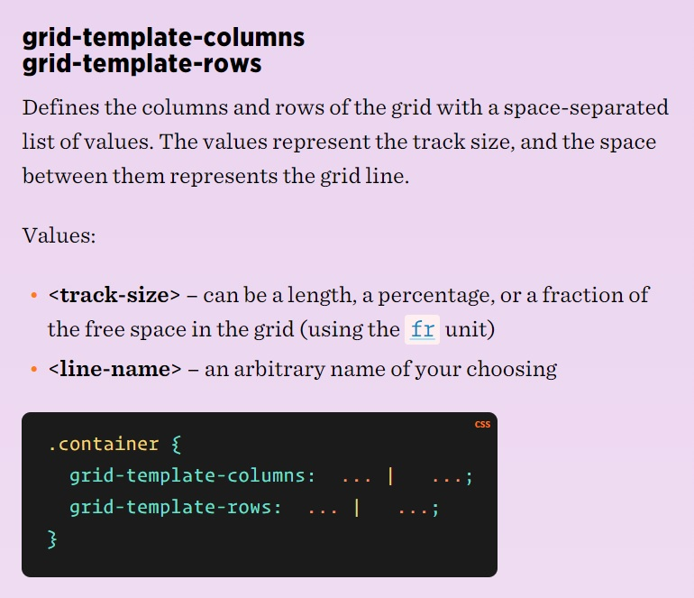
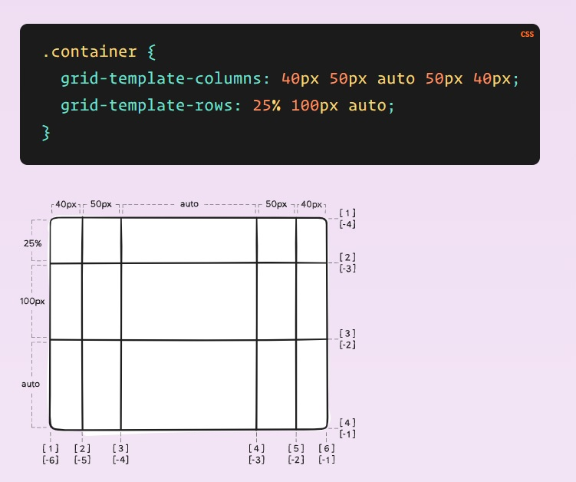
GRID SYSTEM

Slide 25
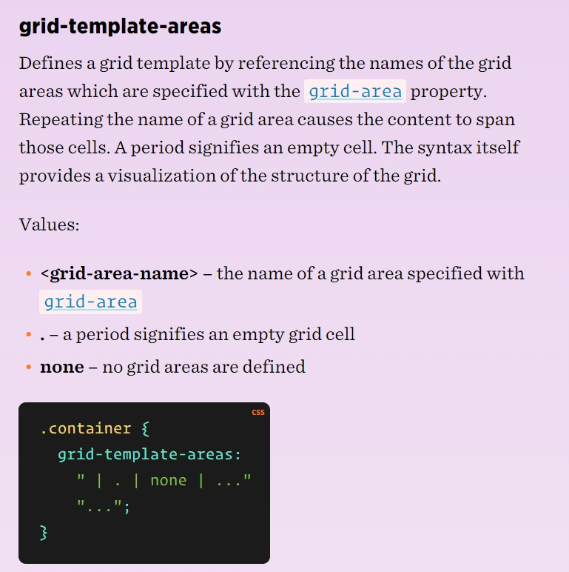
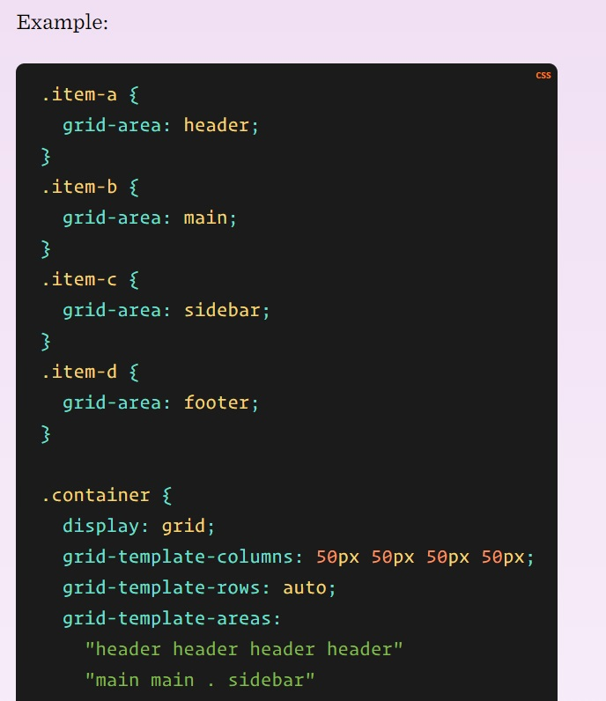
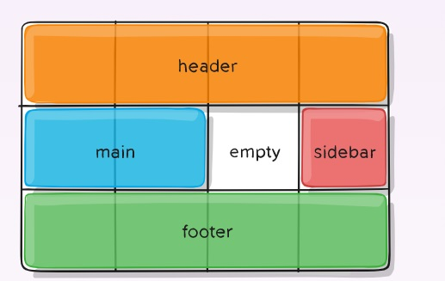
GRID SYSTEM

Slide 26
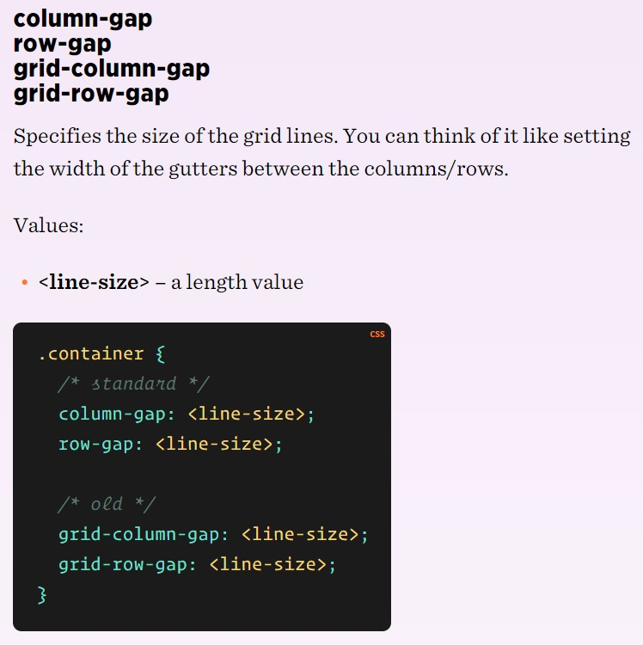
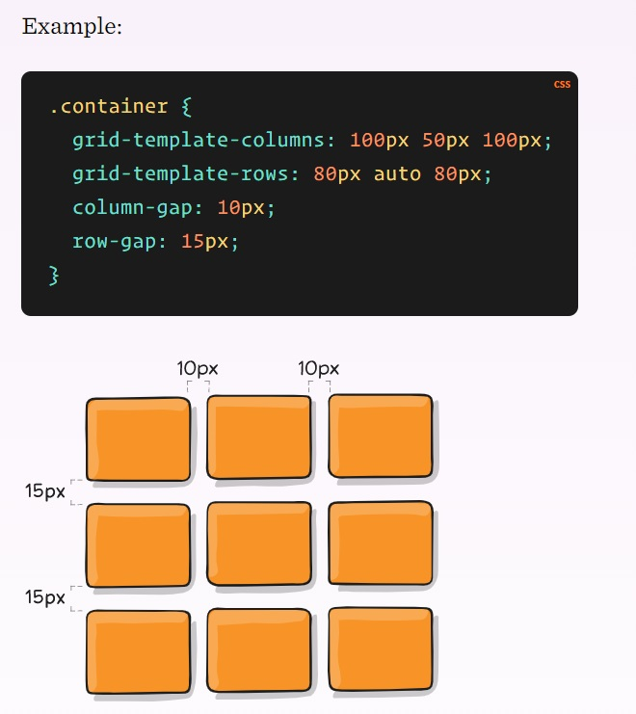
GRID SYSTEM

Slide 27
GRID SYSTEM
Properties for the Grid Container
display
grid-template-columns
grid-template-rows
grid-template-areas
grid-template
grid-column-gap
grid-row-gap
grid-gap
justify-items
align-items
place-items
justify-content
align-content
place-content
grid-auto-columns
grid-auto-rows
grid-auto-flow
grid
Properties for the Grid Items
grid-column-start
grid-column-end
grid-row-start
grid-row-end
grid-column
grid-row
grid-area
justify-self
align-self
place-self

Slide 28
GRID SYSTEM USEFUL LINKS
https://css-tricks.com/snippets/css/complete-guide-grid/
https://css-tricks.com/responsive-designs-and-css-custom-properties-building-a-flexible-grid-system/

Slide 29


